Slide 1
Front End Engineering-I Project
Presented by:-
G27,Team15
Ravneet Kaur- 2210990720
Rhythm- 2210990721 (TEAM LEADER)
Rhythm Trehan- 2210990722
Ridum Sharma- 2210990723
Faculty Coordinator:
Dr. Mandeep Kaur
:
Chitkara University Institute of Engineering and Technology,
Chitkara University, Punjab

Slide 2
TABLE OF CONTENTS
S.NO. | SECTION | PAGE NO.
1. | Introduction | 3-4
2. | Problem Statement | 5-6
3. | Technical Details | 7
4. | Key Features | 8-9
5. | Project Highlights | 10-16
6. | Bonus Features | 17
7. | Conclusion | 18
8. | References | 19

Slide 3
INTRODUCTION
GOOGLE SEARCH ENGINE
Team Members-
Ravneet Kaur
Rhythm
Rhythm Trehan
Ridum Sharma
Purpose of Project-
To organize the world's information and make it universally accessible and useful. So that users can search the internet for content using keywords

Slide 4
Introduction
The importance of search engines in itself is based on their striking features like speed and the way it has made gaining access to information very easy.
Google Search engine is a mainstream engine it is a fully-automated search engine that is used explore the web regularly to find pages to add to our index.
To make the search engine more visually appealing, we used CSS to add styles to the HTML elements. Overall, this project demonstrates the use of HTML and CSS to create an effective tool for research. By making the form visually appealing, easy to use, and functional.

Slide 5
Problem Statement
There are several problems that can arise due to non availability of search engine, including:
Difficulty in finding relevant information: Google is the most widely used search engine, and its algorithm is designed to deliver relevant results to users.
Increased reliance on social media: In the absence of Google search engine, people may increasingly rely on social media platforms to find information.
Decreased innovation: Google has been a major driver of innovation in the search industry. Without it, there may be less competition and innovation in the search market, which could limit the development of new technologies and search methods.

Slide 6
Technical Details
Google Search Engine is a complex web application that is built using various technologies and programming languages. HTML and CSS are just two of the many technologies used to create the Google search engine.
HTML (Hyper Text Markup Language):
A markup language used to create and structure content on the web. HTML provides a set of tags and attributes that are used to define the structure and meaning of content on a web page. Web browsers use HTML to render web pages and display them to users.
CSS (Cascading Style Sheets):
A style sheet language used to add style, layout, and visual effects to web pages. CSS works in conjunction with HTML to define how the content on a web page is displayed to the user.

Slide 7
Key Features
To create a functional and visually appealing replica of the Google search engine using HTML and CSS, some key features that would need to be included are:
A search bar: A search bar should be included in the center of the page where users can input their search queries. This should be designed using HTML input elements and styled using CSS to match the appearance of the Google search bar.
A search button: A search button should be included next to the search bar that initiates the search when clicked. This should be styled using CSS to match the appearance of the Google search button.
Suggested search terms: A list of suggested search terms should appear below the search bar as the user types their search query. This can be achieved using JavaScript to dynamically update the list of suggested search terms based on the user's input.

Slide 8
CONTD…
Navigation bar: A navigation bar should be included at the top of the page with links to other Google services, such as Gmail, Images, and Maps. This can be created using HTML lists and styled using CSS to match the appearance of the Google navigation bar.
Footer: A footer should be included at the bottom of the page with links to other important pages, such as About, Privacy, and Terms. This can be created using HTML lists and styled using CSS to match the appearance of the Google footer.

Slide 9
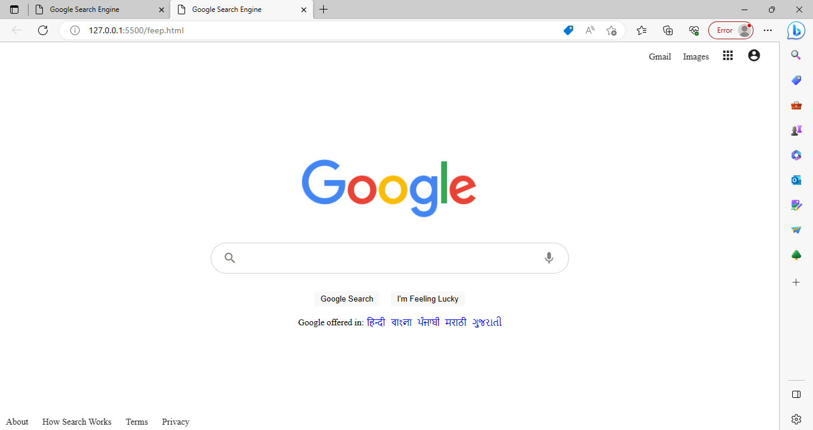
Project Highlights
Screenshots of running Google Search Engine

Slide 10
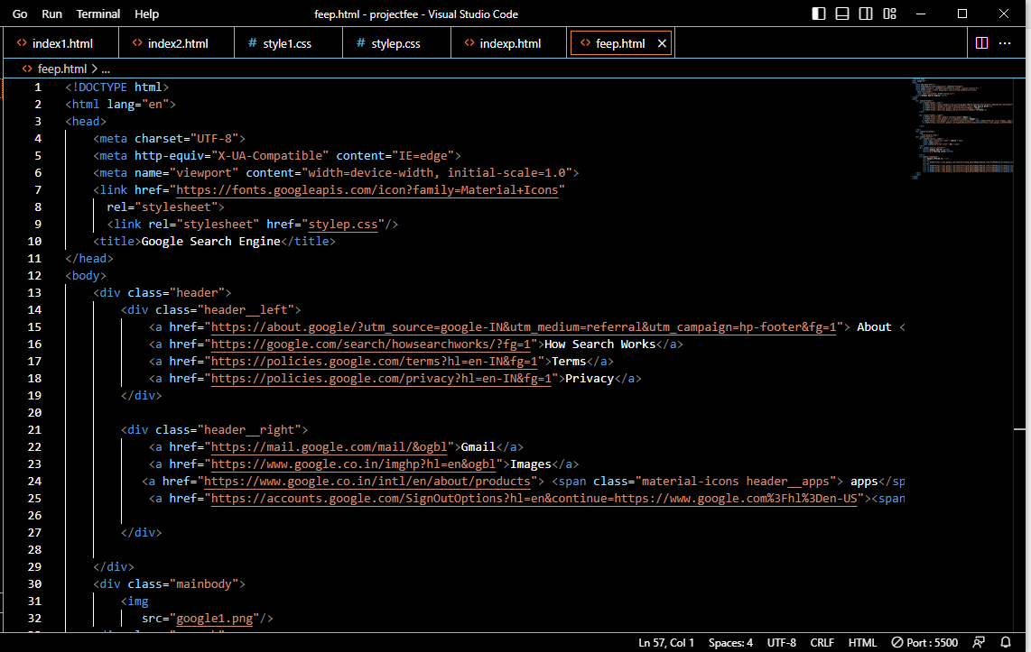
Screenshots Of Html code snippets

Slide 11
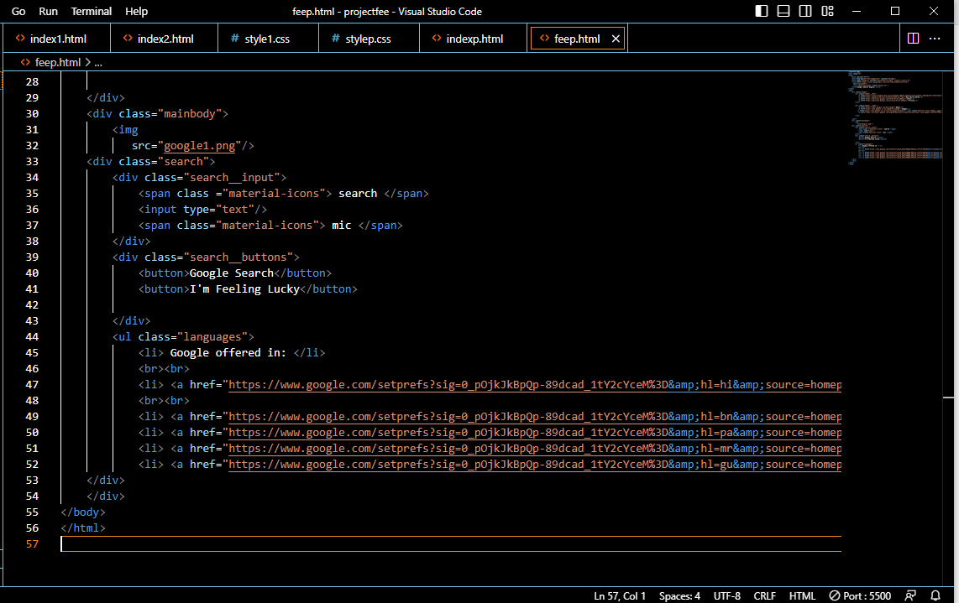

Slide 12
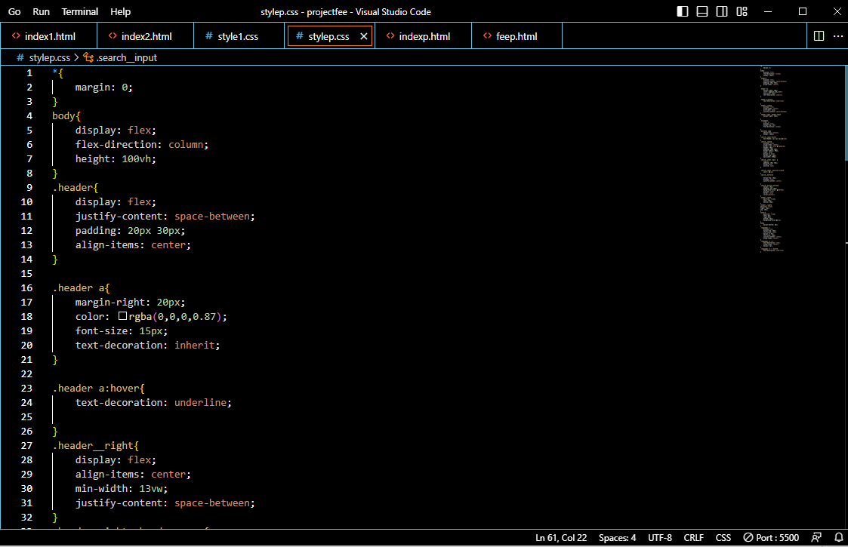
Screenshots Of CSS code snippets

Slide 13
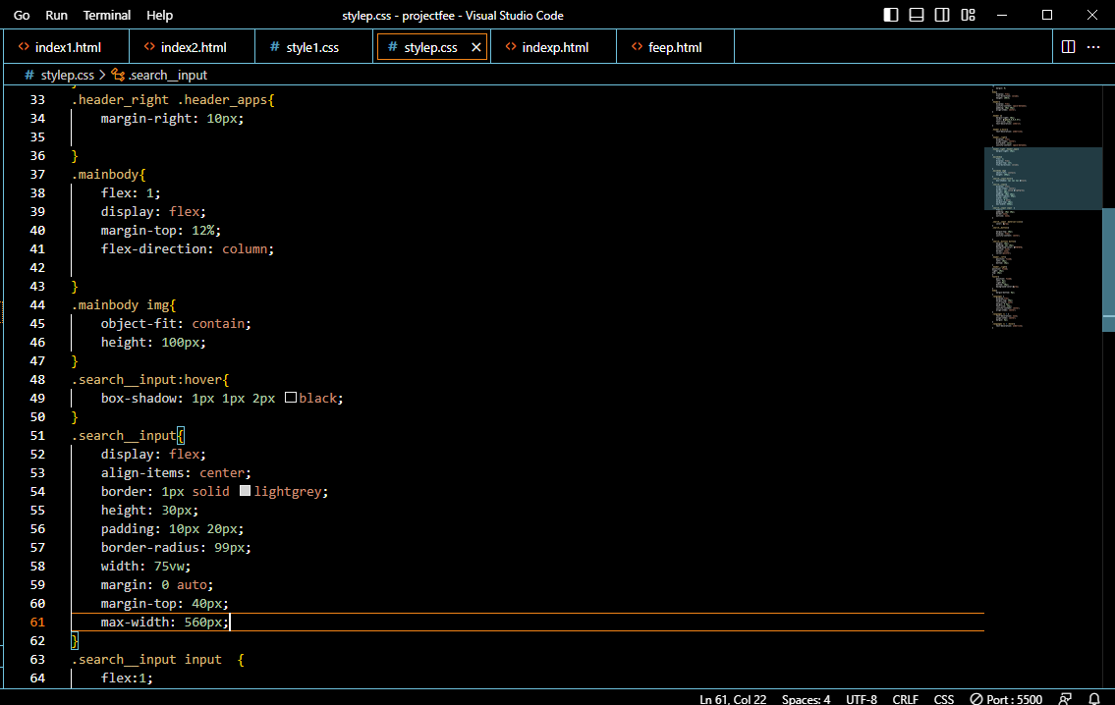

Slide 14
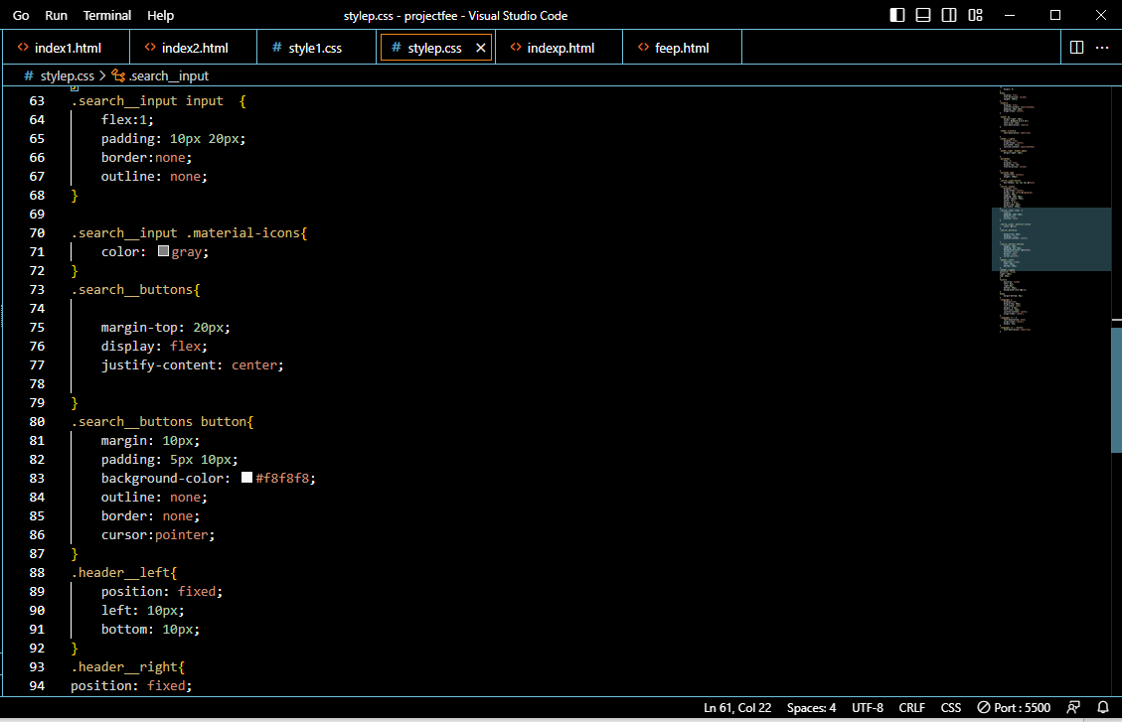

Slide 15
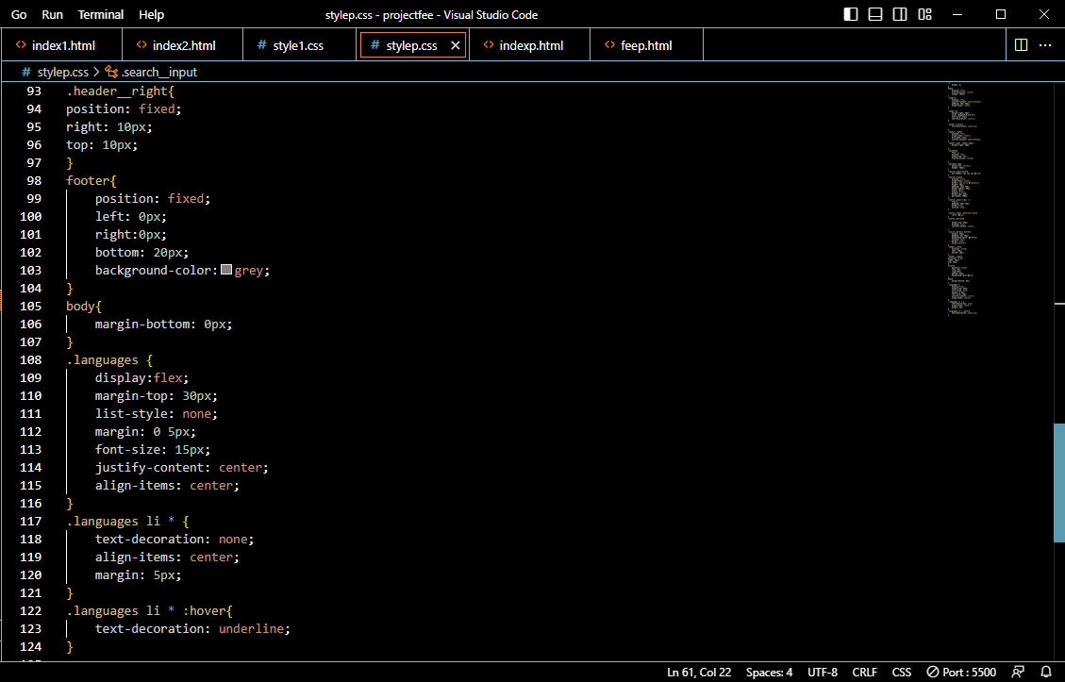

Slide 16
Bonus Features
Our Html Css project is an exact replica of Google Search Engine. It provides various innovative and distinct features which a search engine should provide it’s users. We have included Google search mic which provides user a better user experience(UX) and gives relevant information about the things needed by the user. The user interface(UI) created attracts the user which make using experience more creative and innovative. Our project provides Google workspace option which is Gmail to it’s user where they can arrange their works and meetings and get direct access to their works and mails.
So these are some distinct and innovative features we provide in our project.

Slide 17
Conclusion
Google's search engine interface is built using HTML and CSS.
HTML is used to create the structure and content of the search engine page, while CSS is used to style and layout the page.
In Google search engine we used a variety of HTML and CSS techniques to create its search engine, including responsive design, cross-browser compatibility, and efficient use of code to optimize page load times.
By using HTML’s useful elements and CSS’s design and layout capabilities we created this google search engine.
Additionally, HTML and CSS are easy to learn and widely used technologies that allowed us to create this search engine rapidly and productively.

Slide 18
References/Links used
Links used to create Google features
Gmail: https://mail.google.com/mail/?tab=rm&ogbl
About: https://about.google/?utm_source=google-IN&utm_medium=referral&utm_campaign=hp-footer&fg=1
Privacy: https://policies.google.com/privacy?hl=en-IN&fg=1
How does it works: https://google.com/search/howsearchworks/?fg=1
Images: https://www.google.co.in/imghp?hl=en&ogbl
Apps: https://www.google.co.in/intl/en/about/products

Slide 19


